Slide 1
Changes in U.S. Travel Behavior During the COVID-19 Pandemic
Dr. Don H. Pickrell, Chief Economist
Volpe Center, U.S. Department of Transportation
JEM COVID Panel
October 11, 2022

Slide 2
How We Estimate Travel Time
Use GIS methods to match three different networks and merge link-level data
Daily travel volumes by vehicle class
Distribution of travel by hour of day, day of week, etc.
Speeds by vehicle class
Calculate hourly travel time by vehicle type at link level:
vehicle-hours/hour = (vehicle-miles/hour)/
(vehicle-miles/vehicle-hour) (i.e., speed)
Sum link results by roadway type, time of day, day of week, location (urban vs. rural, individual urban areas, states, etc.)
Long lag time to obtain complete data, so 2021 results not yet available

Slide 3
Matching Details and Shares of Travel Time
Location | Roadway Type | Total KM | % Matched | % of Vehicle-Km | % of Vehicle-Hours
Urban Areas | Expressways | 50,346 | 92% | 9% | 16%
 | Major Arterials | 106,988 | 82% | 6% | 19%
 | Minor Arterials | 180,101 | 5% | 5% | 20%
 | Collector and Local Roads | 1,655,441 | -- | 11% | 21%
Rural Areas | Expressways | 57,663 | 87% | 25% | 6%
 | Major Arterials | 145,963 | 85% | 15% | 5%
 | Minor Arterials | 216,580 | 4% | 12% | 4%
 | Collector and Local Roads | 4,300,571 | -- | 17% | 9%

Slide 4
What We Saw During the Pandemic (2020)
Initial drop in travel was sudden and large, but recovery began quickly and was nearly complete by end of 2020
Hourly distribution shifted significantly
AM Peak travel declined significantly
Mid-day travel affected little on balance, probably due to offsetting shifts
PM Peak declined only slightly, started earlier
Again, initial change was large, but recovery was rapid
Shifts varied significantly among autos, local trucks, long-distance trucks
Commuting delays down sharply in most large cities

Slide 5
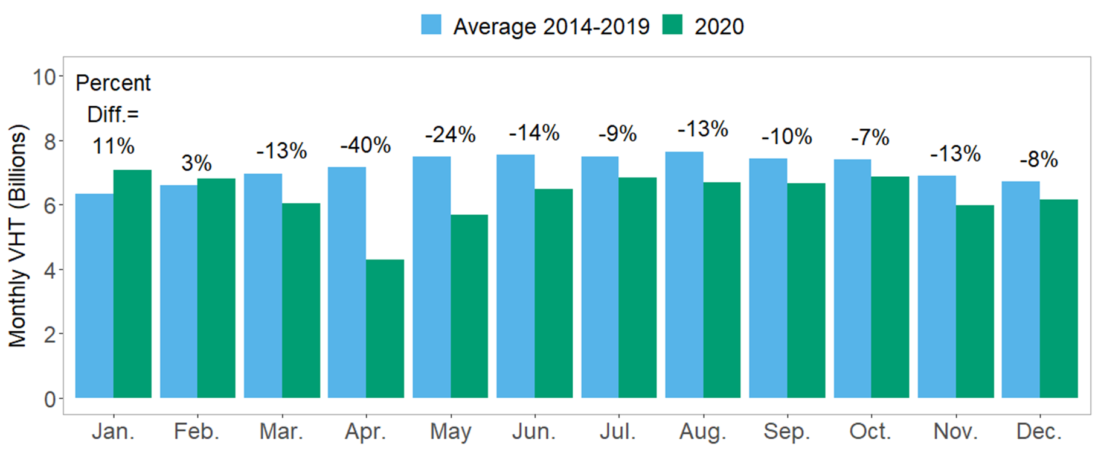
Monthly Travel Time: 2019 and 2020

Slide 6
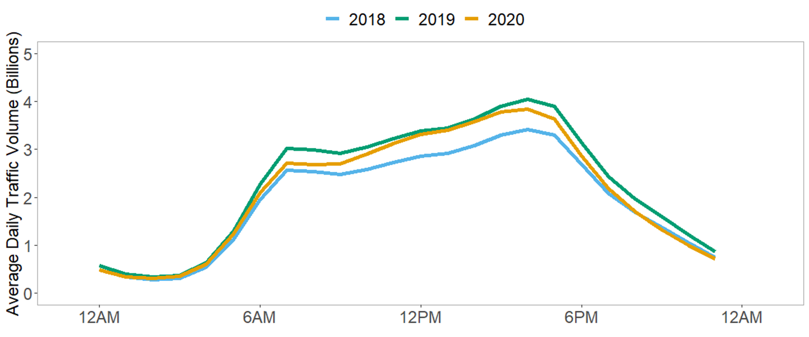
Hourly Distribution of Weekday Travel

Slide 7
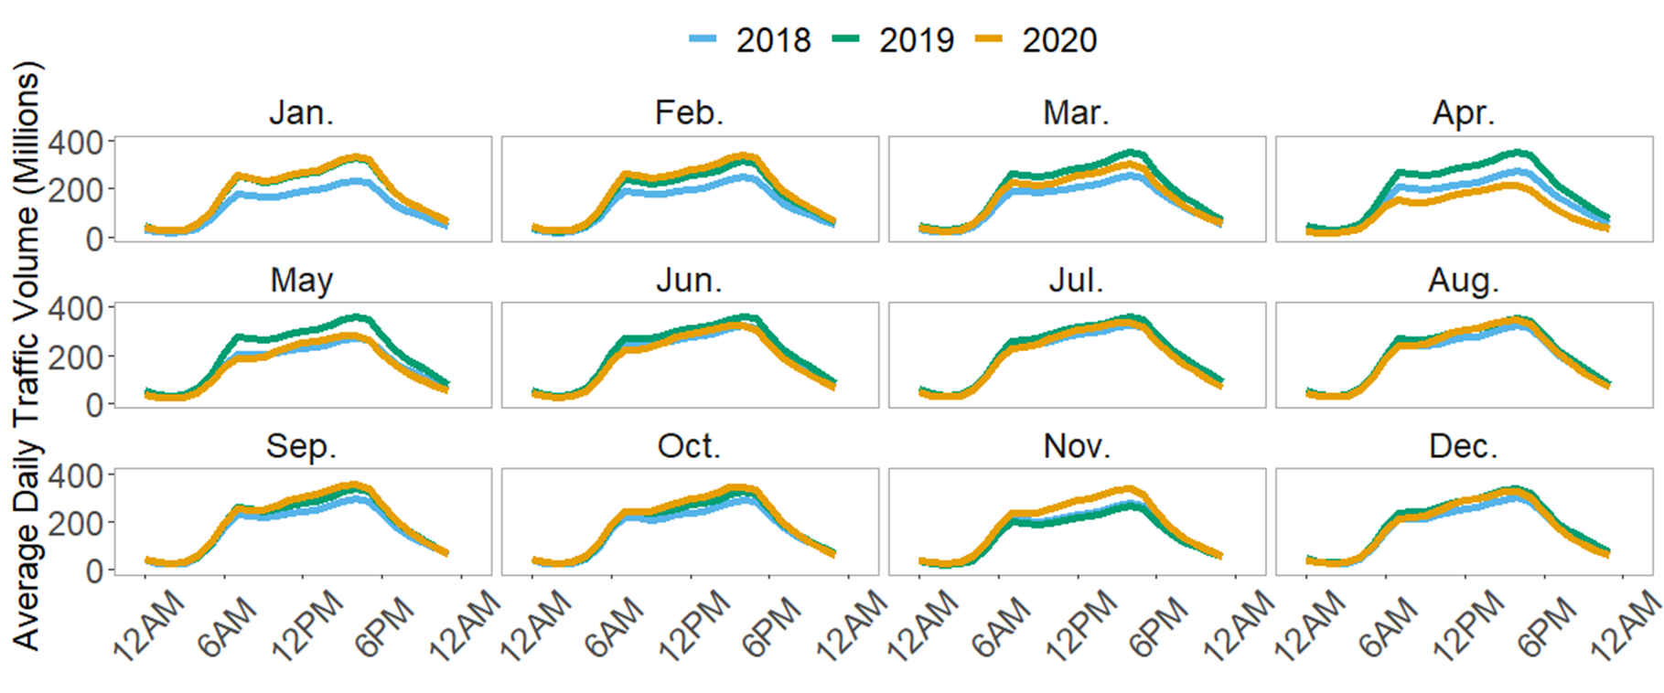
Changes in Hourly Distribution by Month

Slide 8
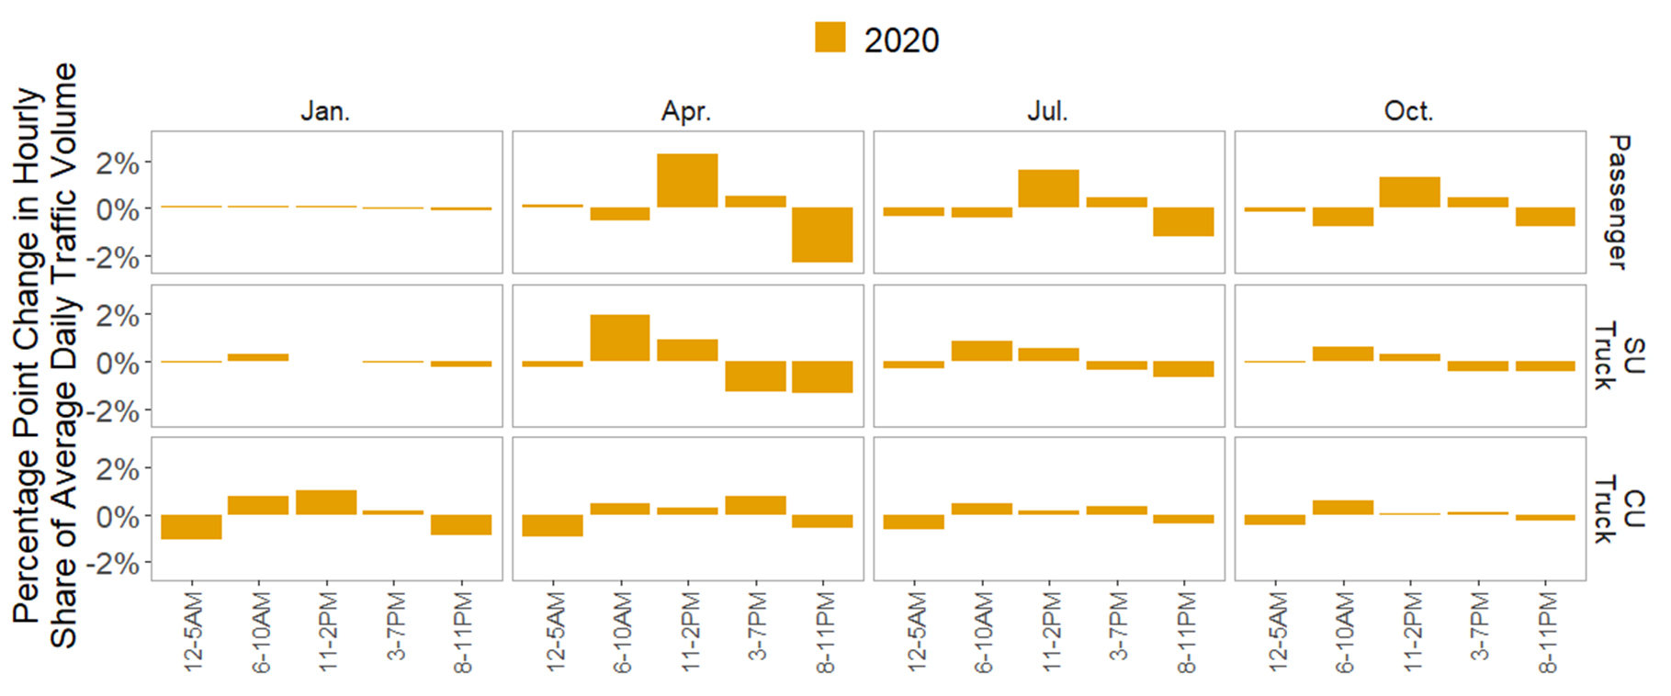
Changes by Month and Vehicle Class

Slide 9
Same Story, but this Time in Words
Vehicle Type | Shift in the Day | From: | To: | Percent of Daily Traffic Redistributed (from 2019)
Vehicle Type | Shift in the Day | From: | To: | January | April | July | October
Passenger | Night and AM Peak to Midday, PM peak | 8PM-10AM | 11AM-7PM | 0.05% | 2.8% | 2.0% | 1.7%
Single-Unit Truck | PM Peak and Night to AM Peak and Midday | 3PM-5AM | 6AM-2PM | 0.3% | 2.9% | 1.4% | 0.9%
Long- Haul Freight Truck | Night to Daylight | 8PM-5AM | 6AM-7PM | 1.9% | 1.5% | 1.0% | 0.7%

Slide 10
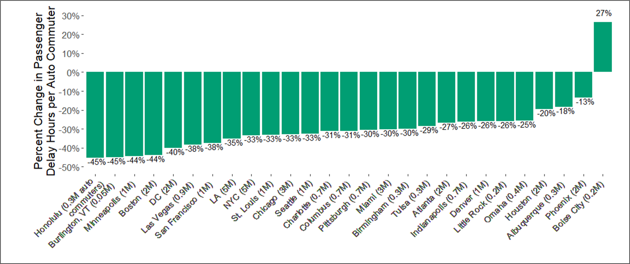
Commuting Delays Largest U.S. Cities

